Slide 1
SOCIALSS
(Social Media Website for Students)
SUBMITTED BY:
DEEP AGRAWAL (18BCE0518)
SHUBHAM AGARWAL (18BCE0542)
UNDER THE GUIDANCE OF:
PROF. Jayakumar K

Slide 2
ABSTRACT
Our project Socialss is a complete MERN stack based social media website designed specifically for students where users will be able to login or new user can register their account on this platform.
After login in, a user can submit posts that will be visible to all the users on the platform. A post will have a like and dislike functionality and the creator of the post can also delete the post from the user’s dashboard.
The platform will have authentication and authorization built-in (using node js middleware) to ensure security to user’s data and post. The website will be extremely performant due to use of latest web technologies such as Node JS and Express for server-side frameworks, MongoDB for database and React JS for Client-side framework.
Socialss will have amazing UI/UX elements to ensure modern and seamless user experience.

Slide 3
MODULES USED
1. Authentication module
2. Authorization module
3. User and Profile module
4. Post module
5. Alert module

Slide 4
AUTHENTICATION MODULE
This module is responsible for login and authorization of the user.
It is implemented using JWT.
Login is implemented by authenticating user’s email and password.
Auto login is also implemented by storing the user’s JWT in the browser’s local storage.
Authorization will be implemented in the backend using middleware.

Slide 5
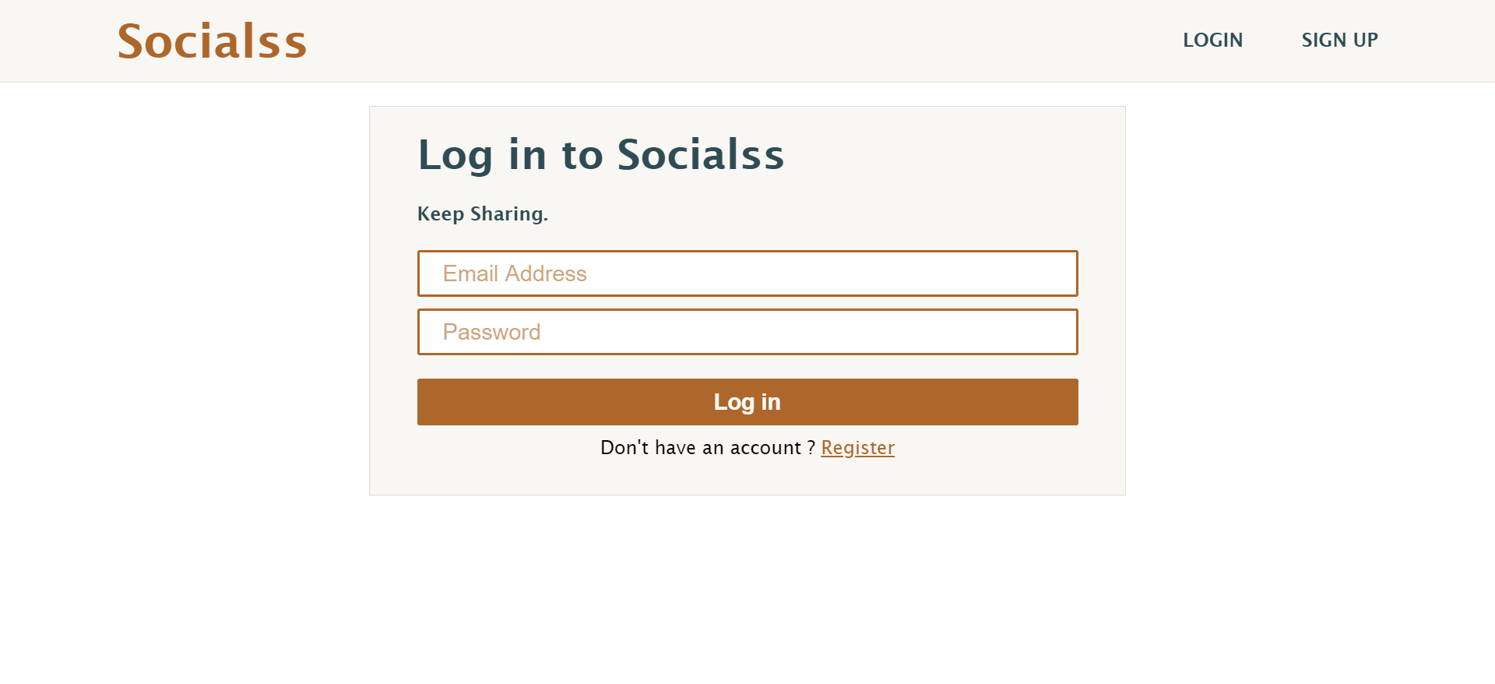

Slide 6
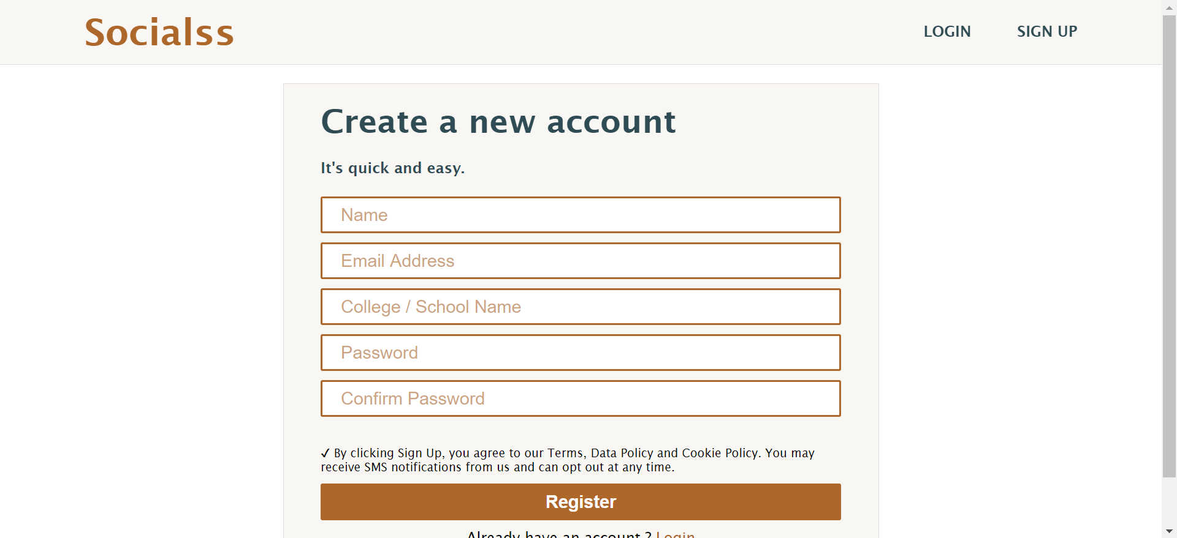

Slide 7
AUTHORIZATION MODULE
This is the middleware that runs every time a new request is made to a protected route.
For example, one user cannot access the page to edit the profile of another user even after accessing the correct route with the URL.
Since after logging in, the authentication token of the user is saved as a header, on requesting a protected route, each time the authentication token is verified to check the authorization to the requested page.

Slide 8
USER AND PROFILE MODULE
This module involves design of the profile view and edit pages of a user and handles the CRUD operation for profile database.
The information that profile can contain includes: experience credentials (company, title, years); education credentials (school, degree, years); career; city; skills; github repos; twitter, facebook, linkedin profile URLs; decription; username.

Slide 9
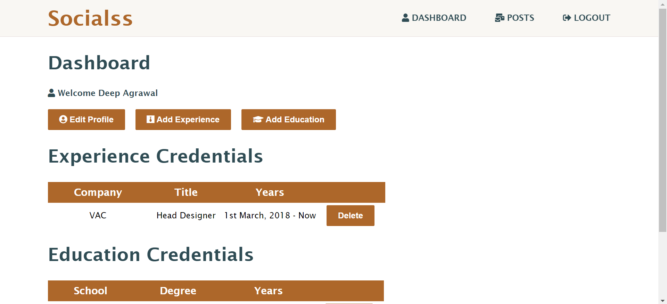

Slide 10
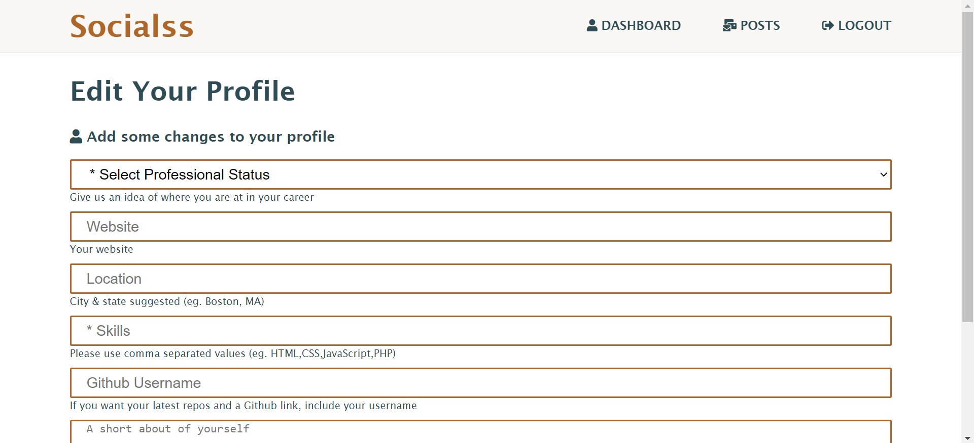

Slide 11
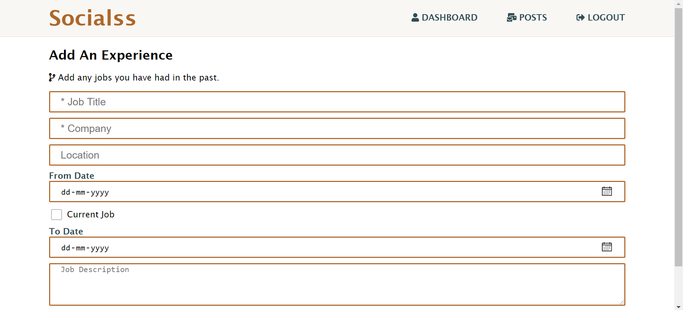

Slide 12
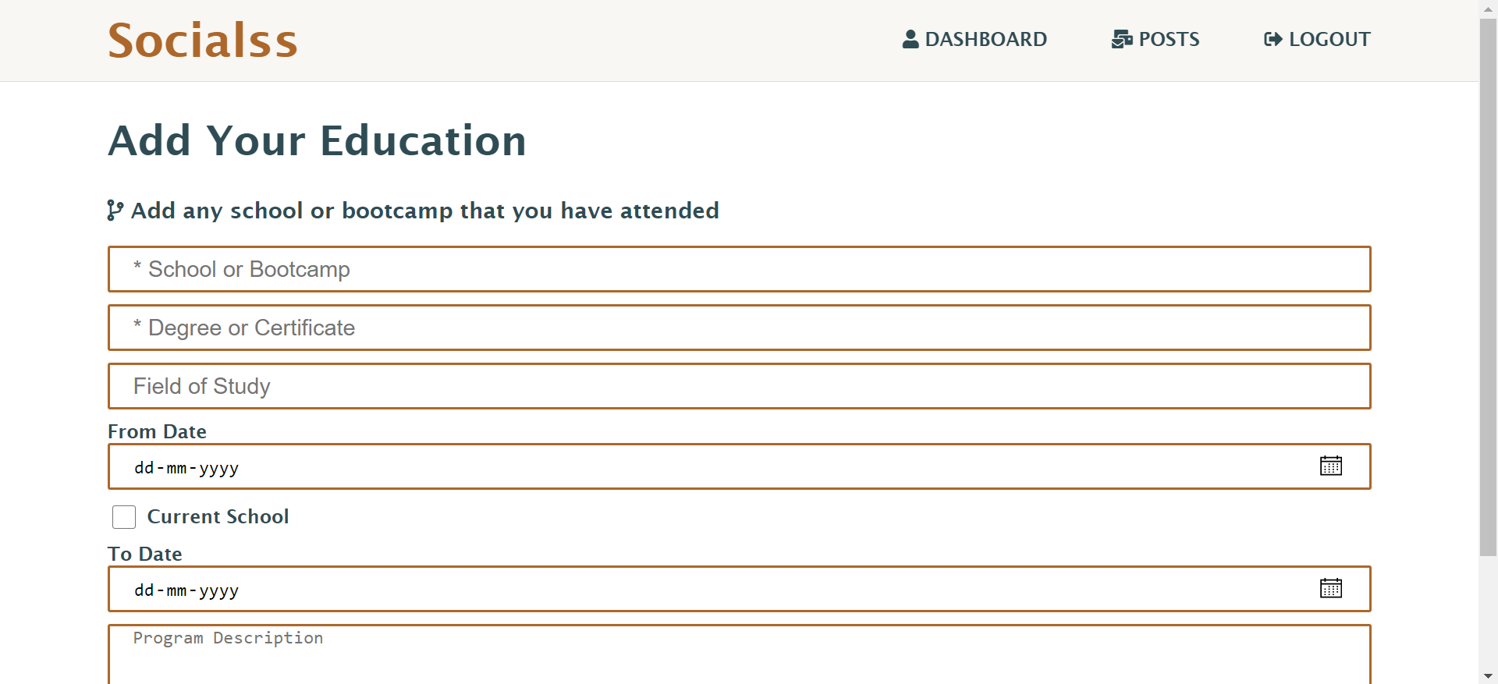

Slide 13
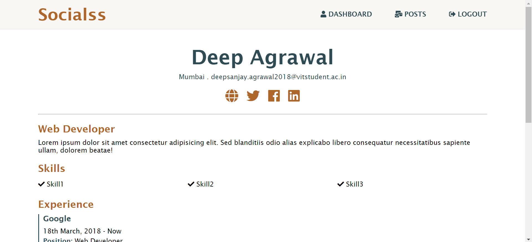

Slide 14
POST MODULE
In this module the user will be able to create a post and see all the post that other users have posted.
User will be able to look at all the post with the details of the user who have posted.
Post module includes two sub-modules:
1) LIKES MODULE.
2) COMMENTS MODULE.

Slide 15
LIKES MODULE
In this module the user will be able to like and dislike a post that is available on the posts page.
The user will also be able to see the count of likes that post has received.
We will make sure a user can like a post only once.
COMMENTS MODULE
In this module the user will be able to comment on the post available on the posts page.
The user will also be able to see the comments of other users on this post.

Slide 16
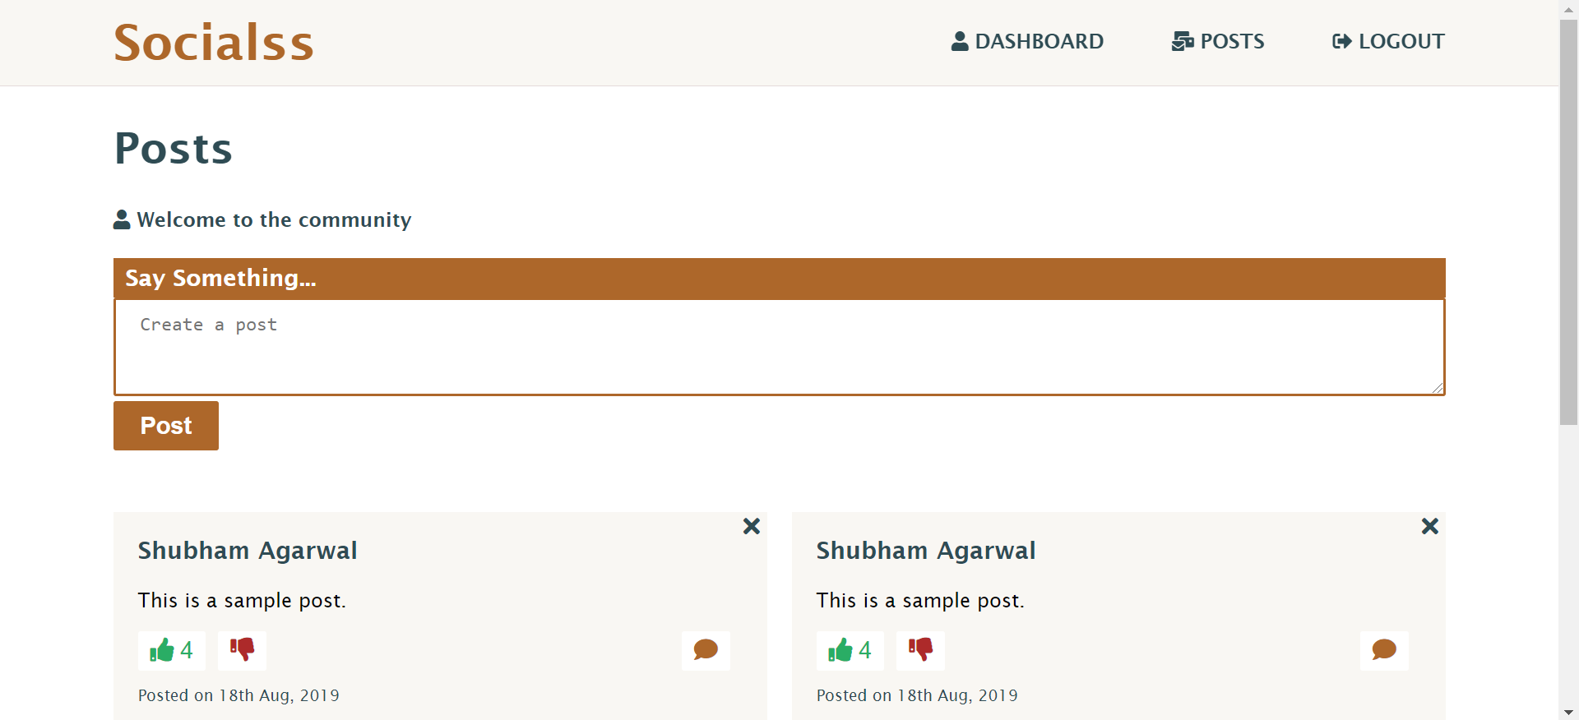

Slide 17
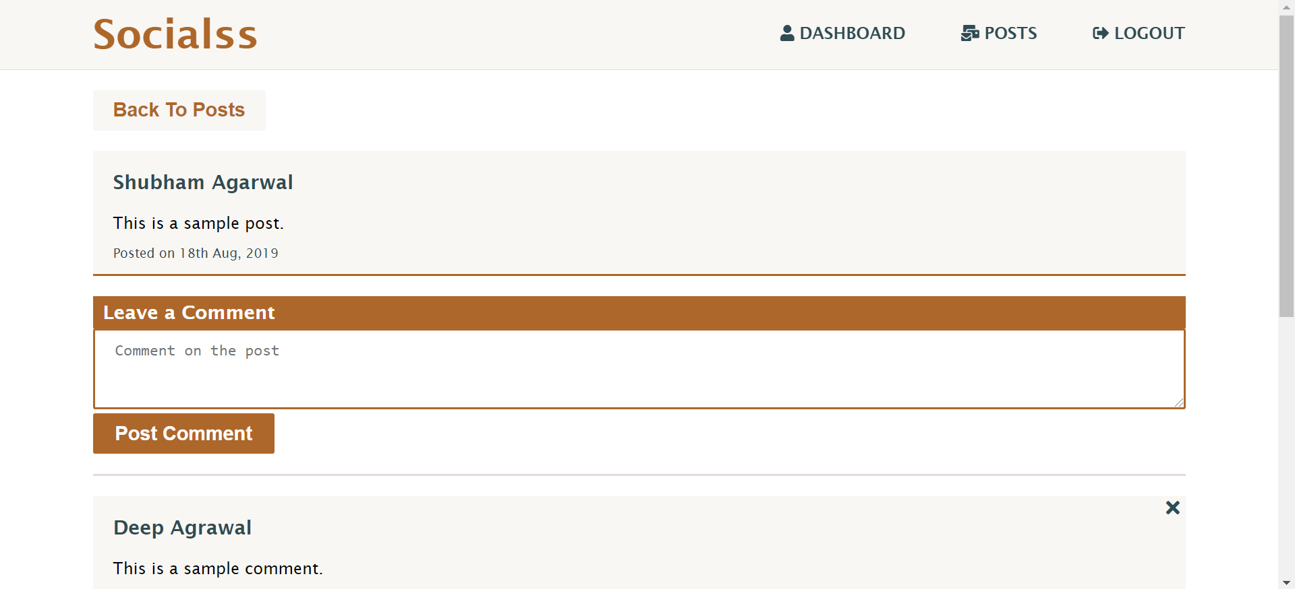

Slide 18
ALERT MODULE
Alert Module is responsible for all the alerts appearing in the website.
Message in the alert can be from both backend and frontend.
This module visually shows message passing between client and server using request response model.

